Slide 1

Project Presentation :
Life is Expected, but at what instant.

Slide 2
“What affects life when life can affect everything. Is always a question that is asked in contrary when a person asks another”.

Slide 3

World Health Organization (WHO)
DATA OVERVIEW
Health Data
Life Expectancy Data (LED)
United Nations Organization (UNO)
Economical data
Data Collection Method:
Stratified Sampling Method
By Doing a sample survey to collect data from people aged (18+) from all countries.
Recording all the general information like(GDP, Alcohol, Total Expenditure, School, etc)

Slide 4

Research Question:
Across Diverse Countries from 2000 to 2015, What is the extent to which Immunization related factors, Economic factor’s show influence on Life Expectancy.?

Slide 5

Summary Statistics
Variable | Mean or n(frequency) | SD or %(percentage) | Median
Life Expectancy | 69.22 | 9.50 | 72
Schooling | 11.99 | 3.26 | 12.1
Alcohol | 4.60 | 3.91 | 4.16
Income Composition | 0.62 | 0.20 | 0.66
Adult Mortality | 164.8 | 124.08 | 144
GDP | 7483.16 | 13136.8 | 3116.56
Dimension(X,Y) | Rows(x) | Columns(Y)
2938*22 | 2938 | 22
Missing data

Slide 6
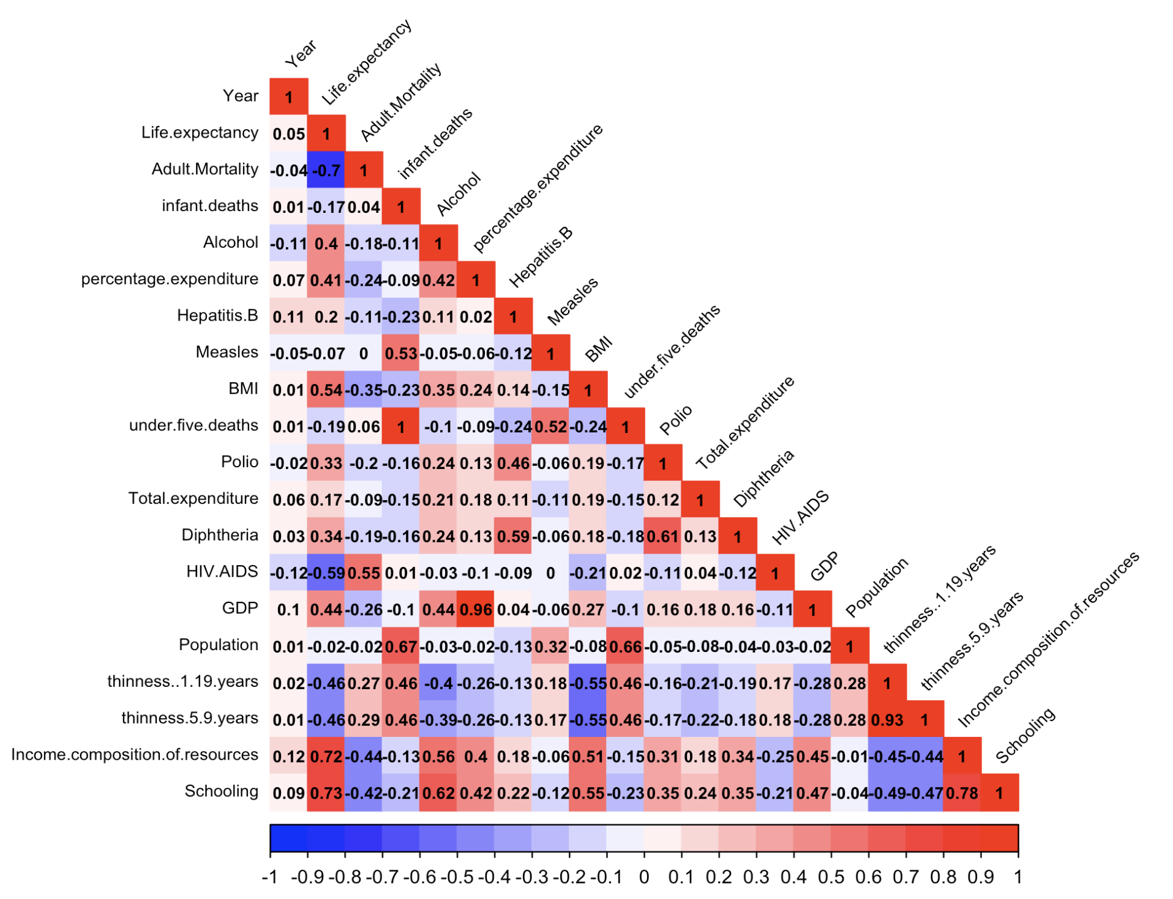
Correlation Plot
Schooling & Life Expectancy - 0.73
Alcohol & life expectancy - 0.4

Slide 7
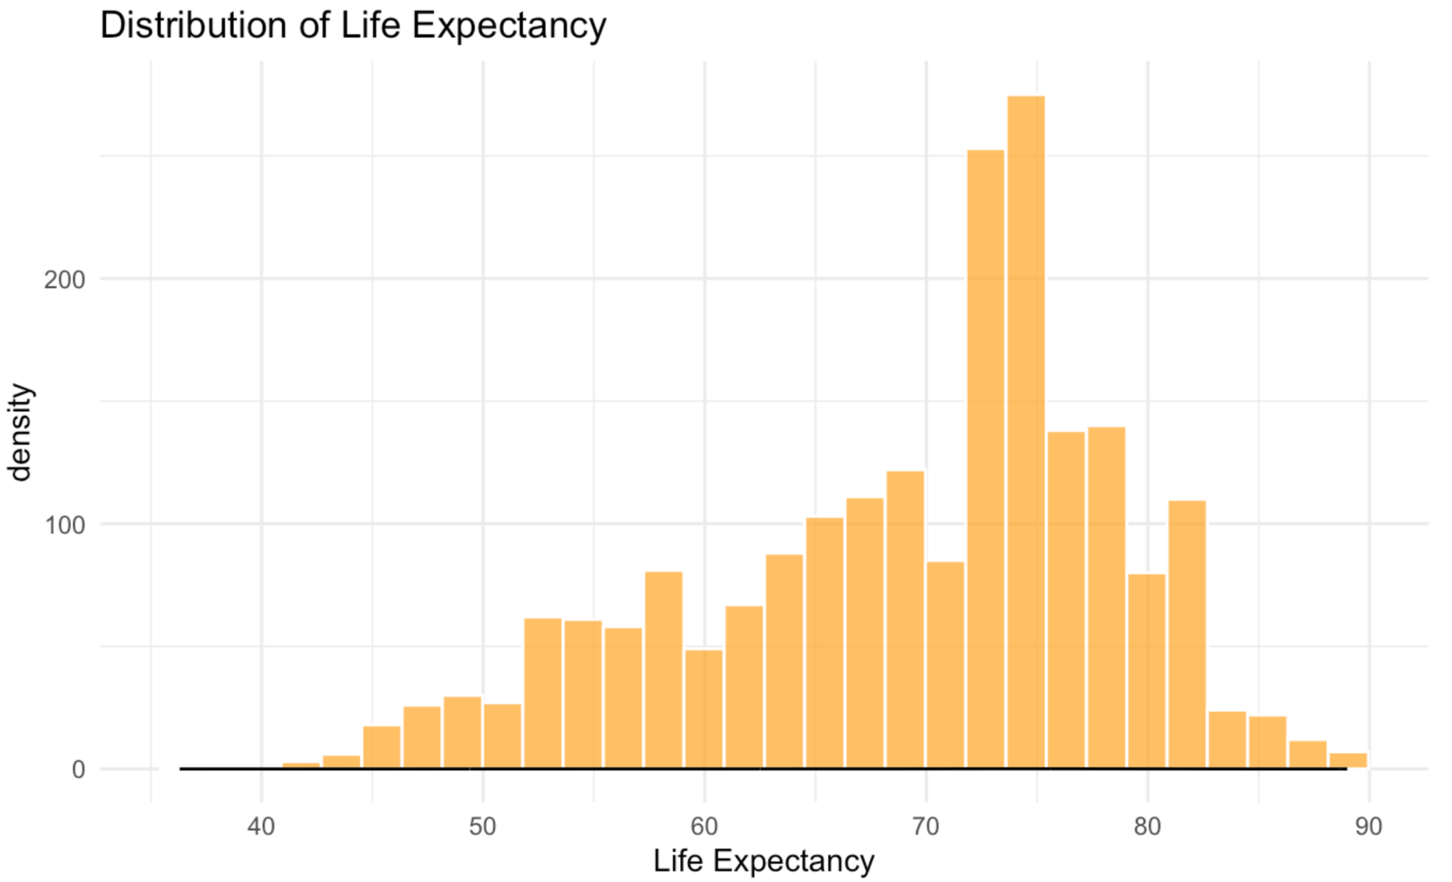
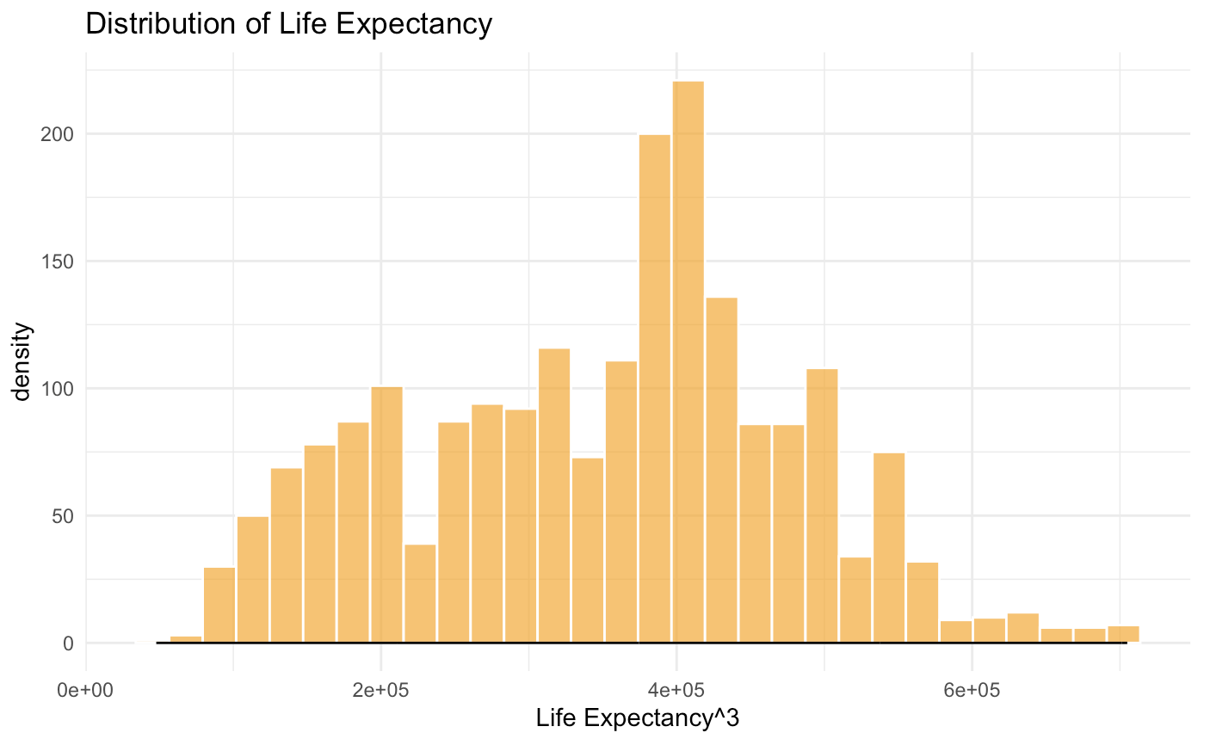
Graphical Data Analysis
Normally Distributed?
No……
Let’s Transform data
Almost normal
Run Model testing and Analysis:
Linear Regression need large data and large space ….. Let's get with the space

Slide 8
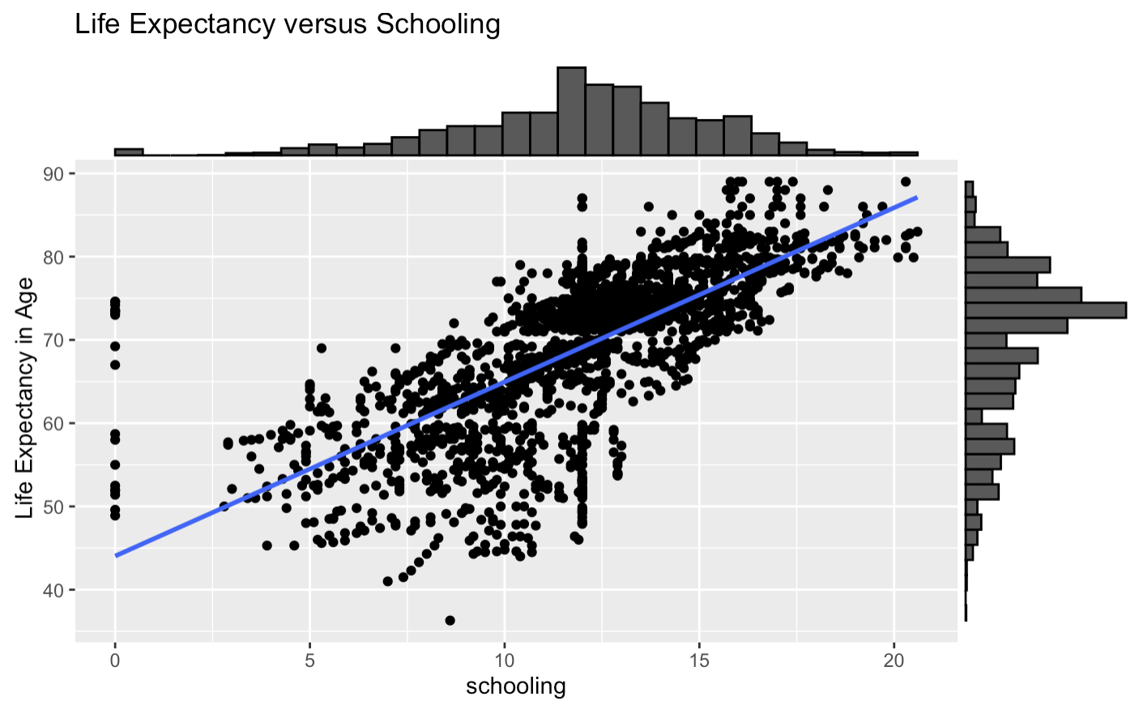
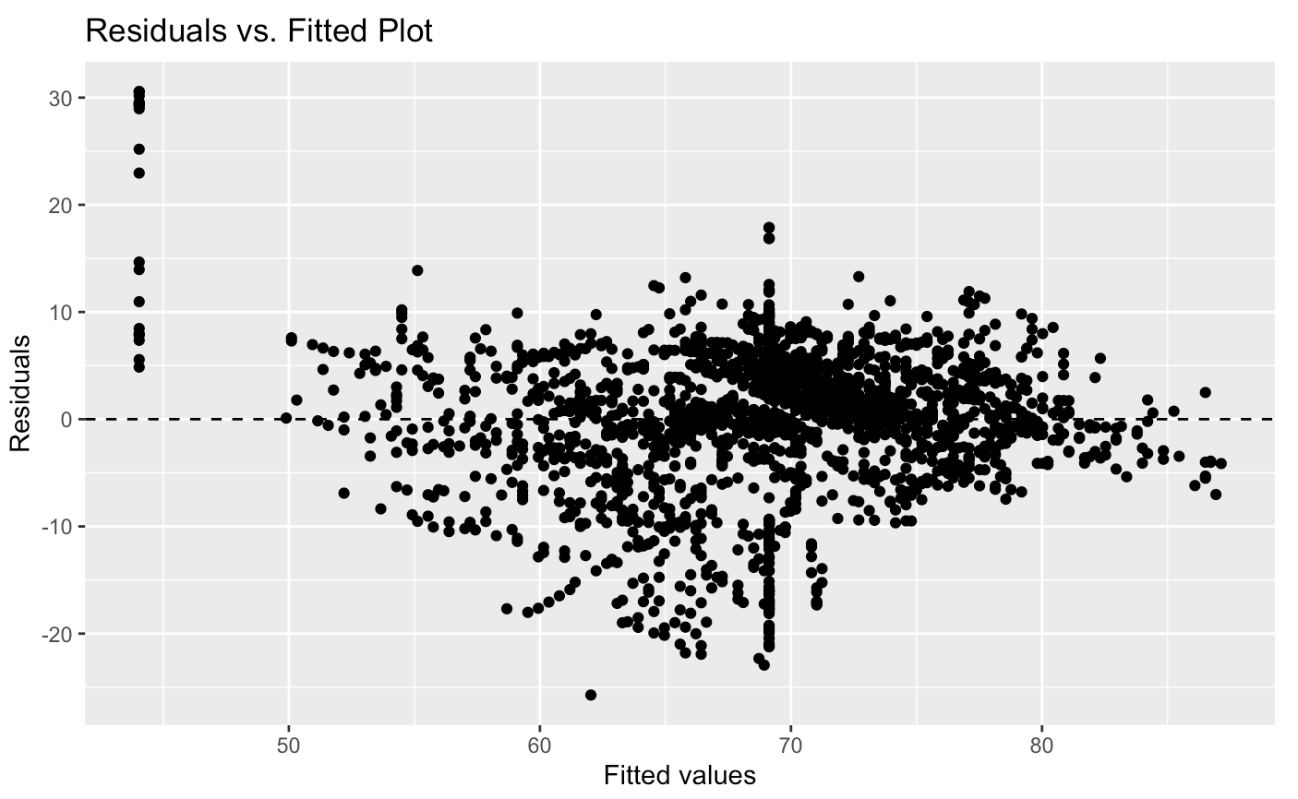
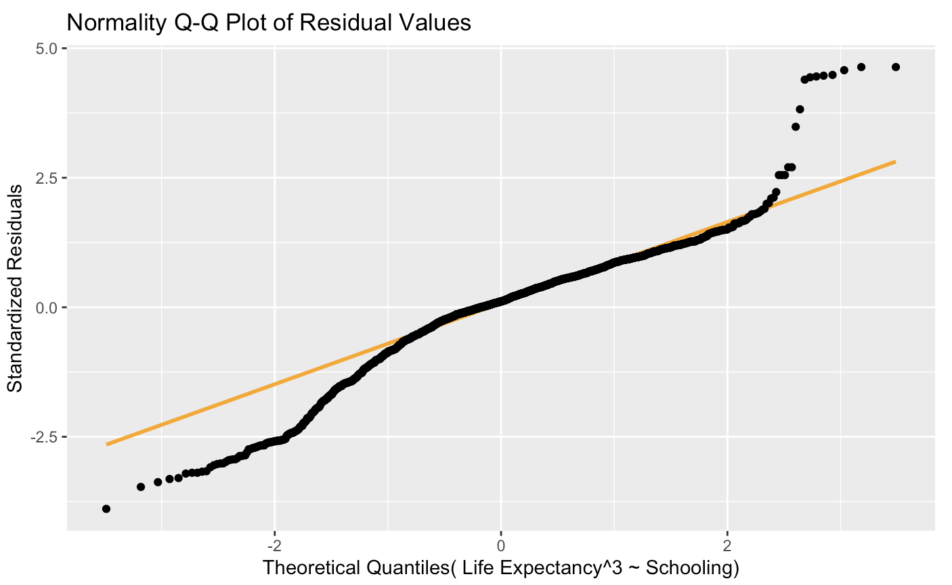
SLR - Life Expectancy to Schooling
Plot looks linear, But histogram for school is left skewed
Independence: all points are independent.
Normality is good not better.
What about outliers. Leverage points?
Residuals are satisfied. With a fan effect
R² Value - 0.51

Slide 9
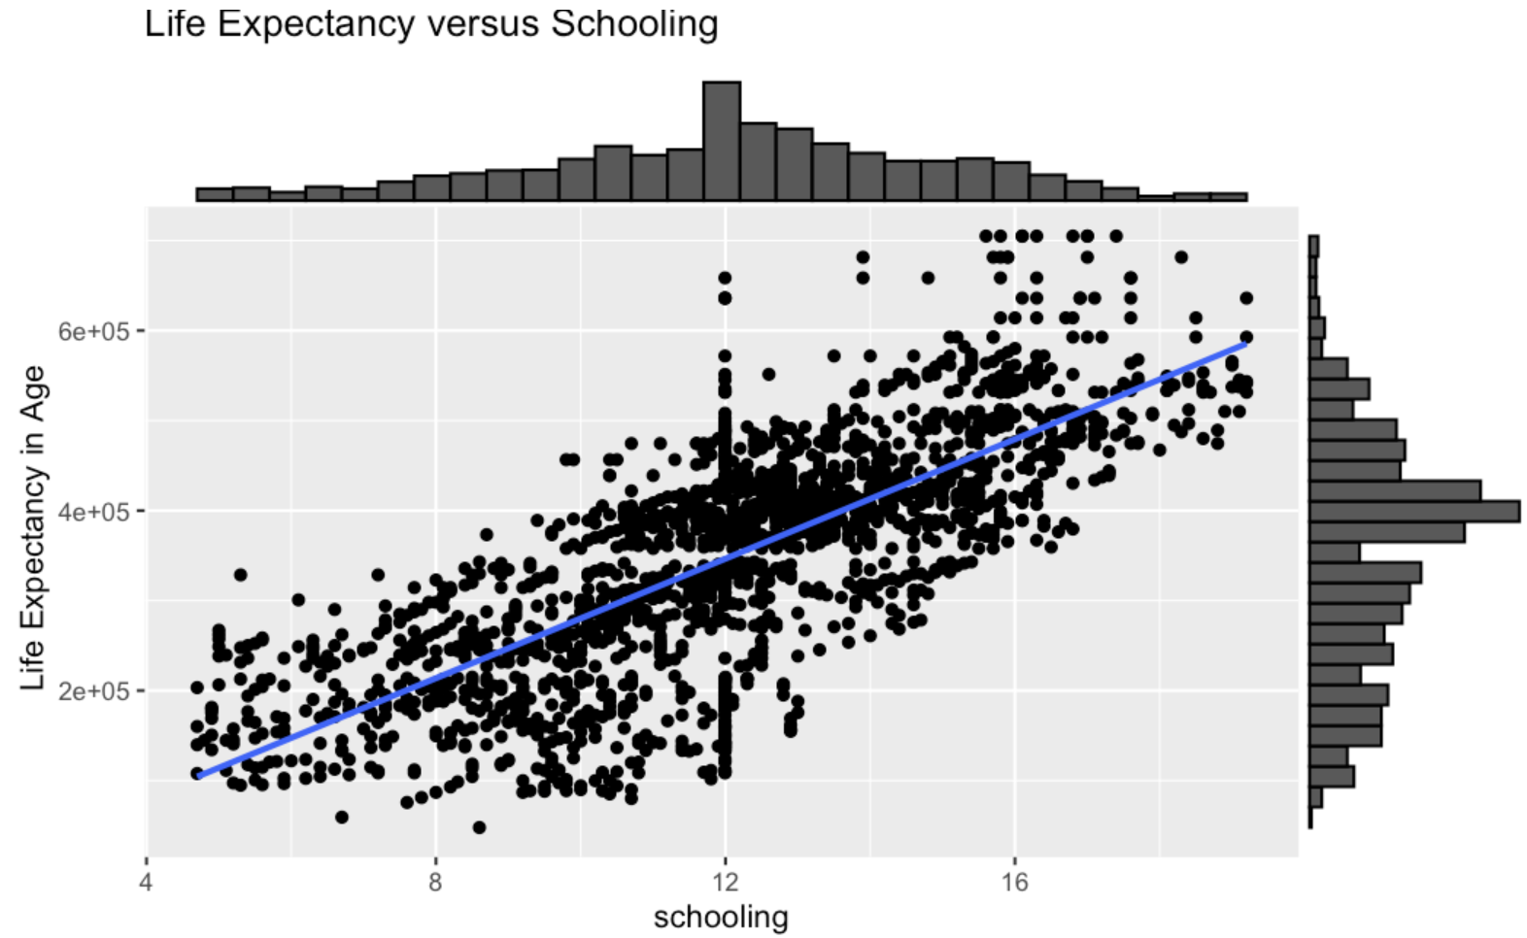
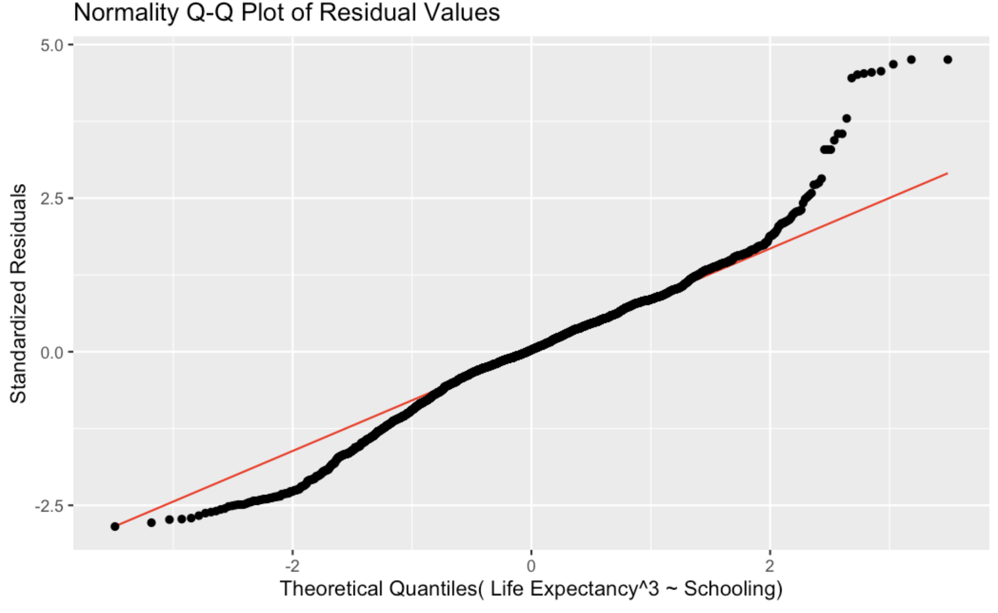
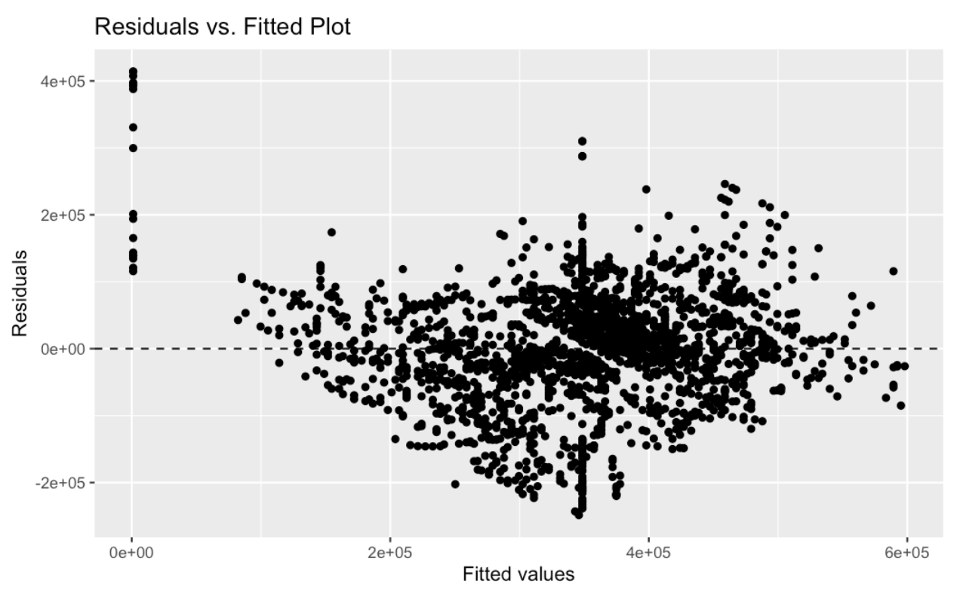
Model without outliers
Linearity : satisfied
Normality: Tails Look good and follow Normal Distribution.
Constant Variance with a little fan effect
R² Value - 0.54 - not much of change, but definitely a change

Slide 10
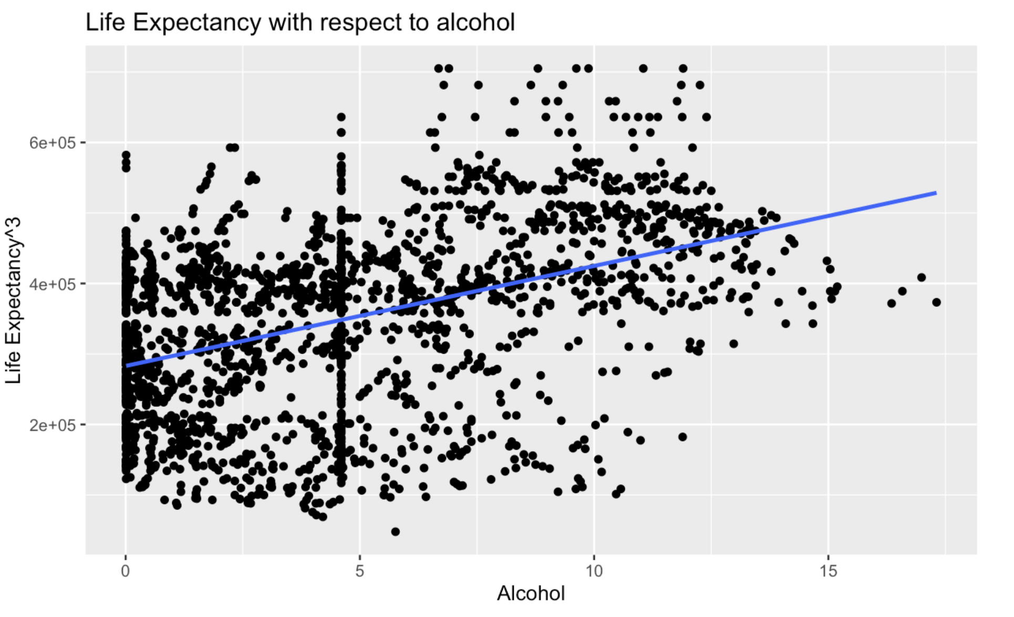

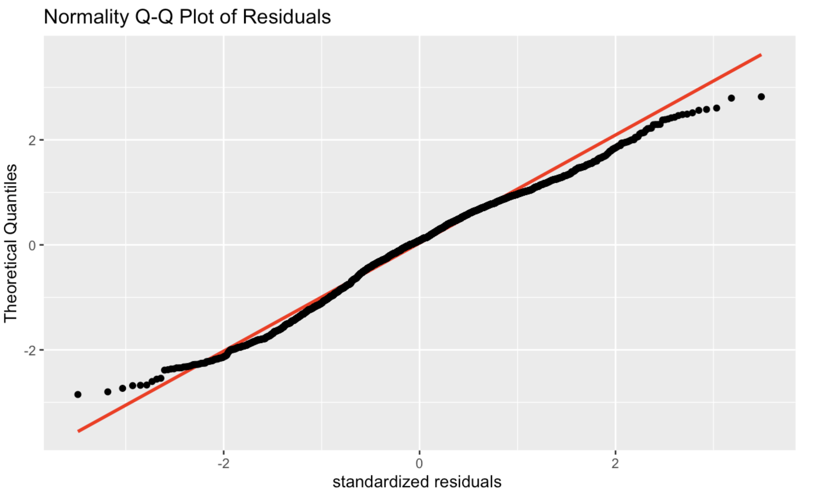

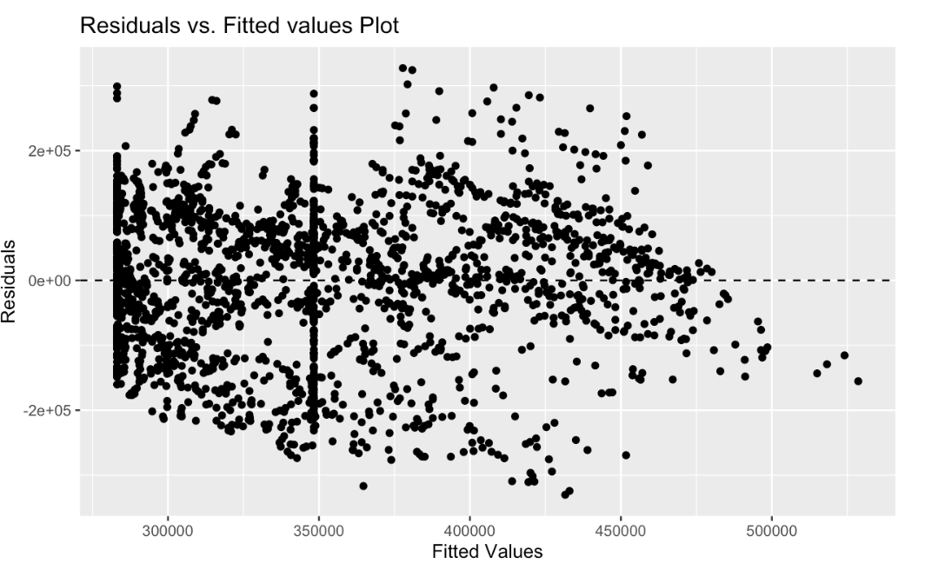

SLR for Alcohol(Immunization factor)
Normality:
Linearity:

Slide 11
Hypothesis test
H₀ : β₁ = 0 & β₂ = 0(no linear relationship between predictor variables Alcohol, Schooling and the response variable life expectancy )
H_{a} : β₁ ≠ 0 & β₂ ≠ 0 (there is a linear relationship between life expectancy and alcohol consumption and no relationship between Life Expectancy and Schooling)

Slide 12
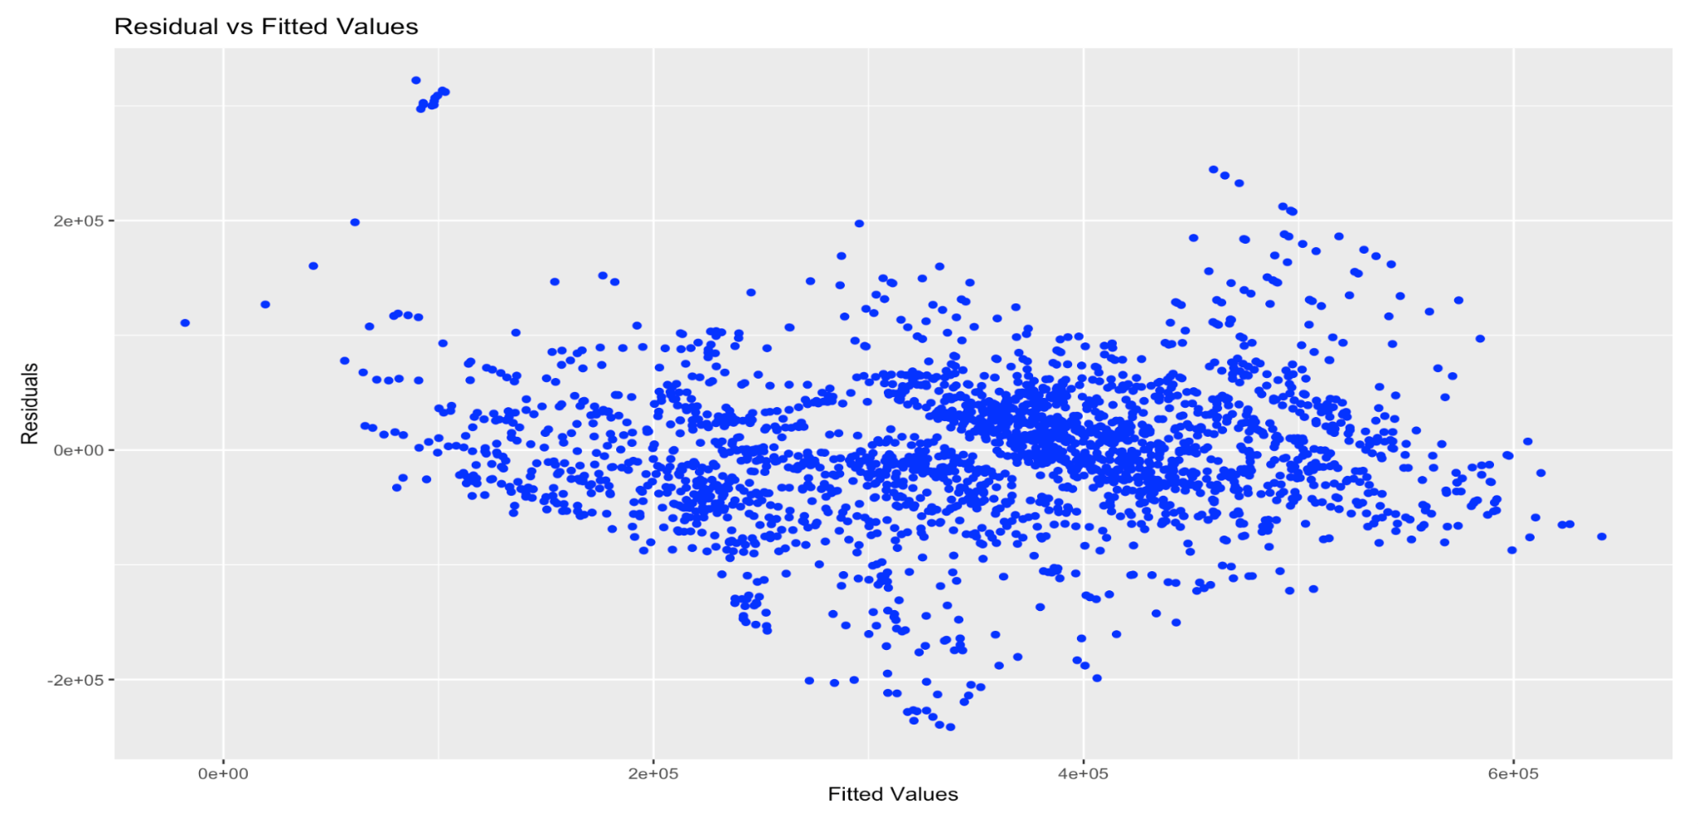
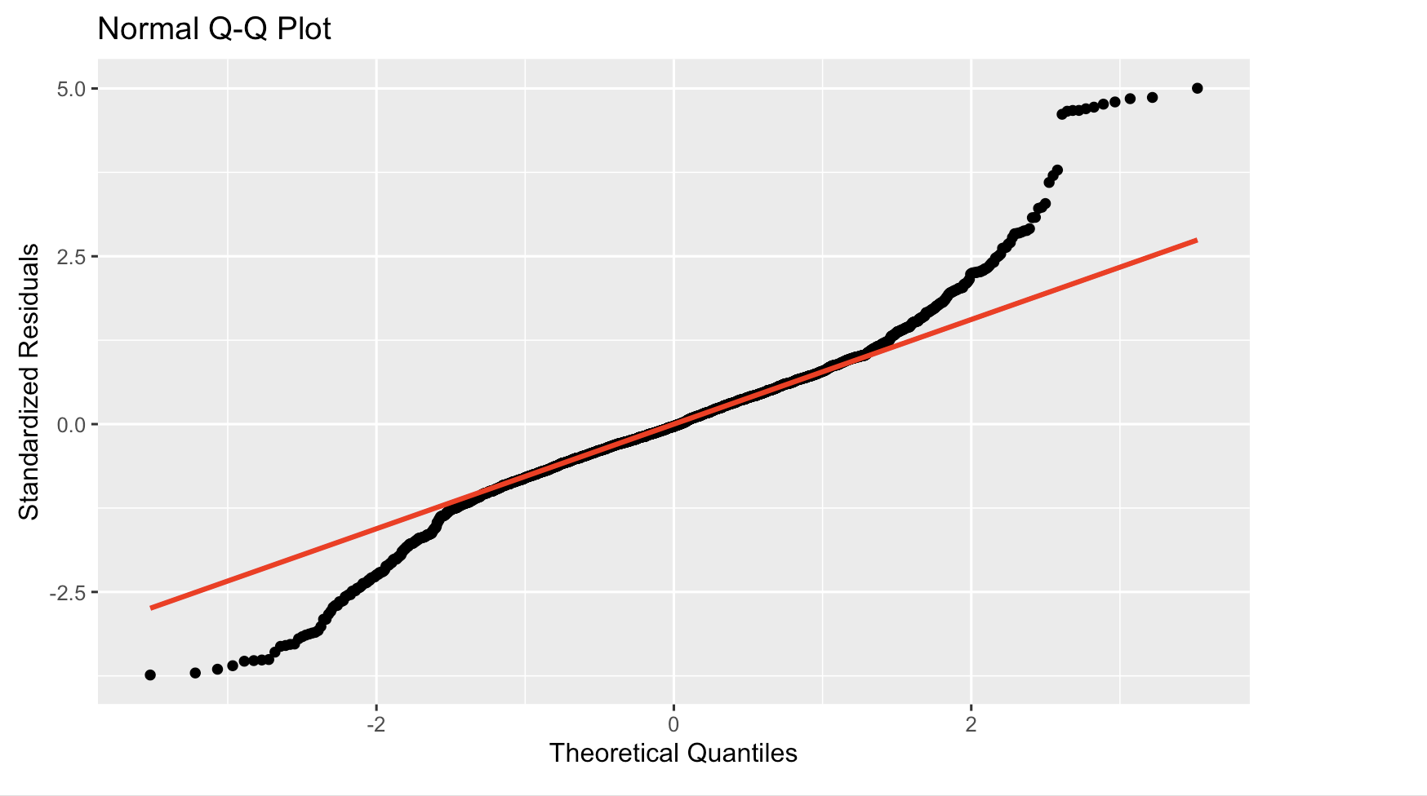
MLR with Effective traits
R² value for MLR model - 0.75
Best fit equation:
Life Expectancy = 103.25 -32.97*adult Mortality +12.27* Income Compositio-1.94* alcohol+19.662*schooling+6.8*gdp + ϵ

Slide 13
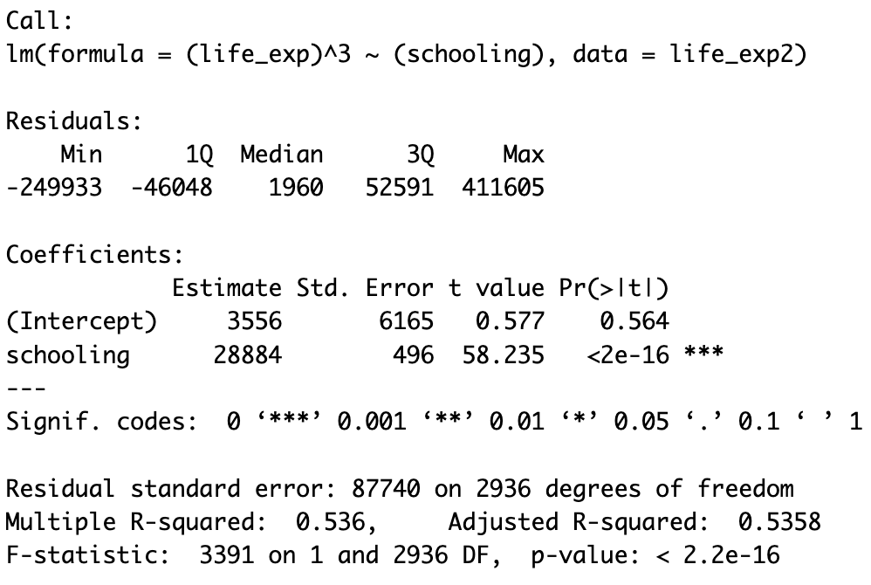
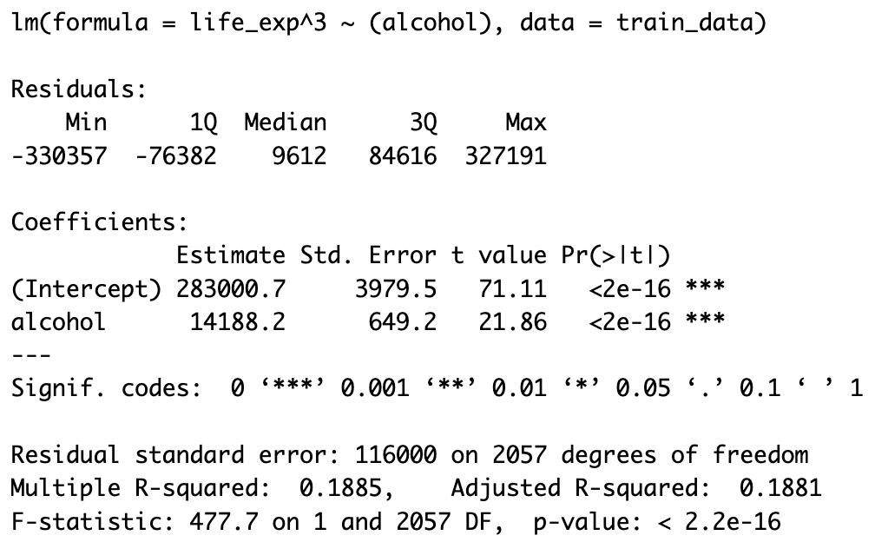
Result’s
Life Expectancy VS Schooling
Life Expectancy vs Alcohol

Slide 14

Conclusion
Life Expectancy to School: P-value ≈ 0.
Final Model:
Life Expectancy to alcohol: P-value ≃ 0
Final Model:

Slide 15
Resources
Source Code Links: Project-630-vikas
MLR: Multi Linear regression code and explanation
The data Has been collected from public websites and all the credit goes to respective Publishers

Slide 16
Thankyou
— Naveen Kumar Kaparaju
Vikas Reddy Bodireddy

